Slide 1

Sakai Assessment Manager
“Samigo”
Charles Kerns, Stanford University
charles.kerns@stanford.edu
Lance Speelmon, Indiana University
lance@indiana.edu

Slide 2

This presentation:
Part 1
  Overview and Functionality
  Charles Kerns, Stanford University
Part 2
  Technical Description
  Lance Speelmon, Indiana University
In the audience
  Cailtin Intermill, Lead Designer, Indiana
  Marc Brierley, Lead Designer, Stanford

Slide 3
What is Samigo?
Asynchronous, Web-based Interaction Model:
  Instructor asks questions
  Student responds; gets feedback (immediate or delayed)
  Instructor grades and makes comments
A Sakai tool for creating, distributing, taking, and grading assessments.
  Assessment = quiz, problem set, paper, homework, test, survey, self-study questions.
Questions and Assessments can be
organized and shared.
Notes:
Remember to say that this is a beta

Slide 4
Where did the design originate?
Formative Assessment (Homework)
  Stanford Assignment Tool for Human Biology
  CourseWork CMS with Language Tools
  (Andrew W. Mellon Foundation funded)
  OKI Tools Workshop to Specify Functionality
  (Andrew W. Mellon Foundation funded)
  OKI Formative Assessment Tool
  (Andrew W. Mellon Foundation funded)
OnCourse Quiz & Test Tool
  Online testing
Notes:
Notice the Mellon Funding
Stanford Assignment Tool for Human Biology
Weekly problem set assignments for 300+ students.
Efficiency for large lecture courses
Auto-grading of homework assignments
Multiple sections
Multiple authors of assignments
Linkage to gradebook
Better communications between teaching assistants and students
Student-submitted rationales with each multiple choice question
Identify groups of students with common misunderstandings
Easy for teaching assistant to comment on each student’s work
CourseWork for Language Instruction
Funded by Mellon as part of the OKI project
Multimedia questions
Audio responses by students
Special testing modes

Slide 5
Where did the design originate?
OKI Tools Workshop
  Many schools met to define needs for a CMS
  One group specified the needs for an Assessment Tool
  Several hundred functional requirements identified

Slide 6
Where did the design originate?
Assignment and Assessment Manager
  Supports teaching and learning in
  large lecture science courses and in language instruction
  OKI Tool
  Andrew W. Mellon Foundation funded
Oncourse CMS for Indiana University
IMS QTI

Slide 7
What are its features:
Assessment Authoring
Assessment Publishing
Assessment-taking Management
Assessment Grading
Question Pools Management
Publishing Template Management
Notes:
<show front page>
This is the control center for instructors. This is where they see the status of their assessments and can navigate to carry out functions:
Authoring Assessments
Create New Assessments
Questions and Sections
Publishing-organization Settings
To which groups
When released, due, retracted
Late Handling
Feedback
Layout
Grading Responses
Auto
Manual
Question Pools
Sets of questions with metadata
Import and Export
Publishing Templates
Create types for different use cases
Hide complexity from instructors
Assessment-taking Management
Saves and submissions
Timed Assessments

Slide 8
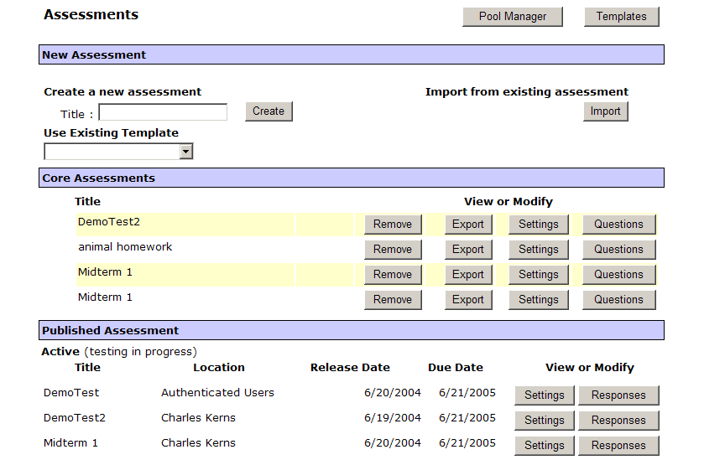
Notes:
<show front page>
Authoring Assessments
Create New Assessments
Questions
Sections
Assessments
Publishing-organization Settings
To which groups
When released, due, retracted
Late Handling
Feedback
Grading
Grading Responses
Auto
Manual
Question Pools
Sets of questions with metadata
Import and Export
Publishing Templates
Create types for different use cases
Hide complexity from instructors

Slide 9
Organize & Publish Assessments
Library of assessments for a course
  Can be ex/imported in QTI XML format
Published assessments with responses, grades
  Can be published to sections, groups in course
  Can have different release, due, retract dates

Slide 10
Notes:
Core Assessments are the library of assessments.
They can be exported, imported, and published.
Published Assessments are those given to course.
They can be taken and graded

Slide 11
Question Types
Multiple Choice (single and multiple correct)
Multiple Choice Survey
True/False
Matching
Essay/Short Answer
Fill in the Blank
File Upload
Audio Recording
Notes:
Show Assessment Page, create a new assessment using the Homework template.
Create a multiple choice question and display the pull down with the types of questions.

Slide 12
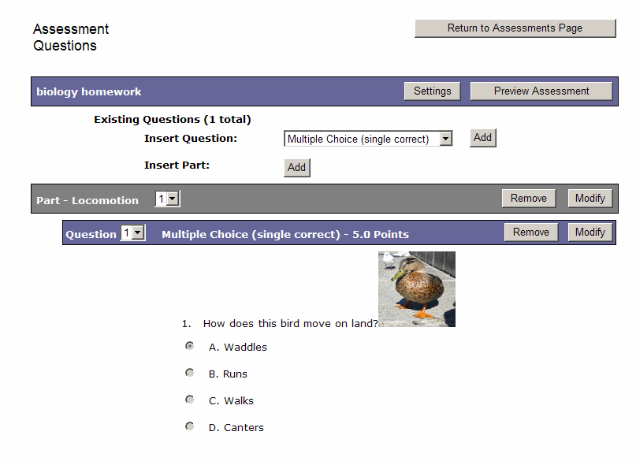

Slide 13

Multimedia Everywhere
WYSIWYG editor
  Fonts, layout, lists, images, file uploads, links
In section headers, question texts, selections for responses, feedback, comments
Notes:
<Show question Authoring>
Show Assessment Biology Homework Question 2

Slide 14
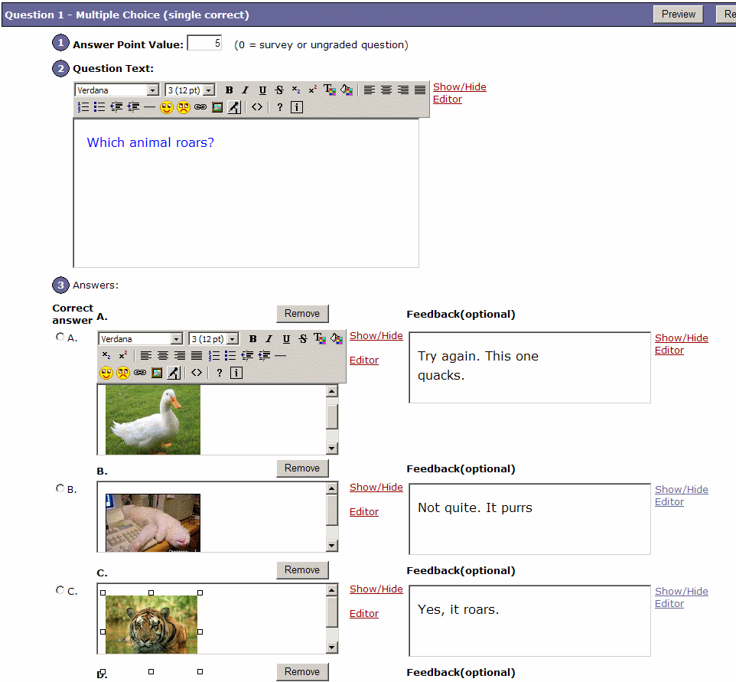

Slide 15
Pedagogical Flexibility
Online Test
Self-study questions
Homework, problem-sets
Essay, code, or project submission
Language drills
Quick knowledge probes

Slide 16
Online Test
Unique tests for each student
  Randomized order of questions
  Randomized draw from question pools
Timed test-taking during access window
  Auto-submit at end of timed period
One submission only
Higher Security
  IP Addresses restricted
  Secondary Password (proctored)
No late submissions accepted
Scores transferred to gradebook
Notes:
<show settings – timed, security, gradebook

Slide 17
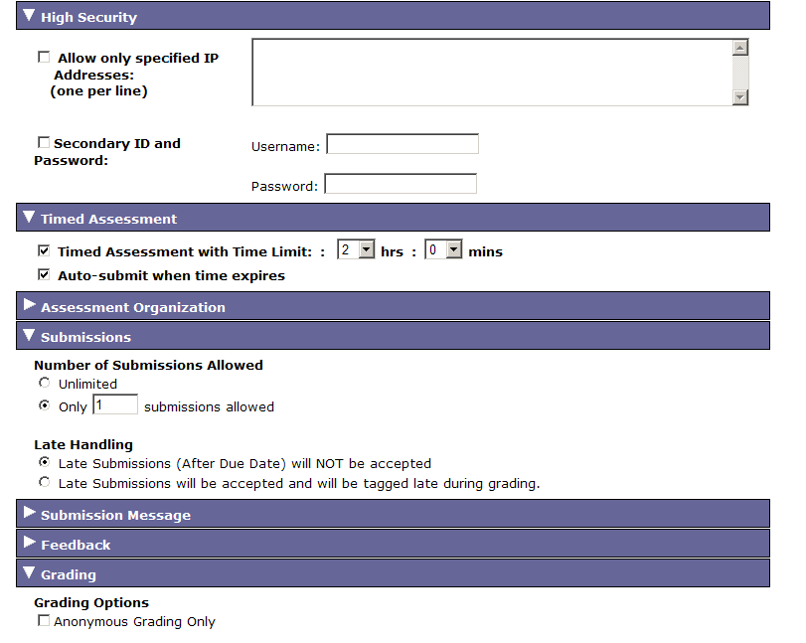

Slide 18
Self-Study Questions
Immediate feedback
Random access to Q’s during quiz-taking
  Table of contents
  Marked for review list
No record of score in gradebook
No due date; always available to student
Unlimited submissions allowed
Notes:
<show settings immediate feedback
Show random draw in authoring>

Slide 19
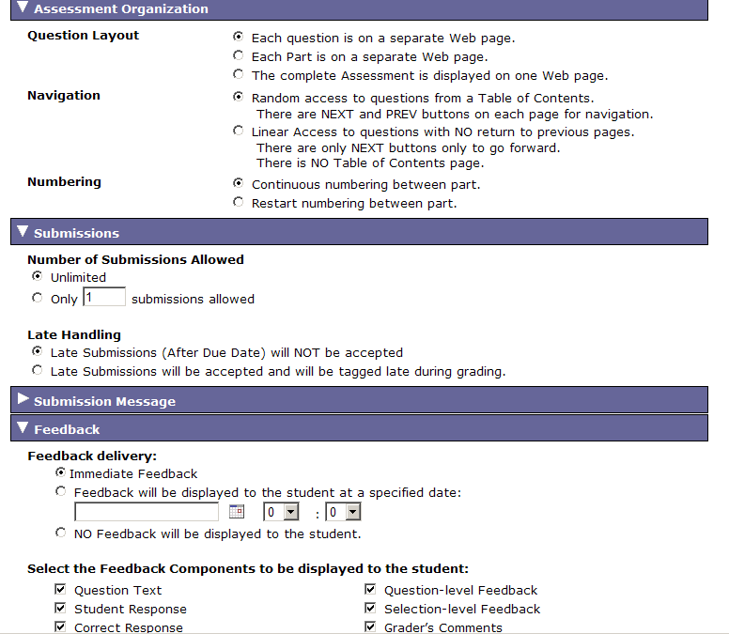

Slide 20
Homework/Problem Sets
Published with multiple release and due dates for different sections
Multiple methods for handling late submissions
Students can save work during assignment period.
Auto-grading with methods for question type for diagnosing learning problems
Quick-reviews of student aggregate performance by instructors viewing histograms, statistics.
Pools for organizing questions for reuse
Notes:
<Show due dates, sections, late submissions

Slide 21
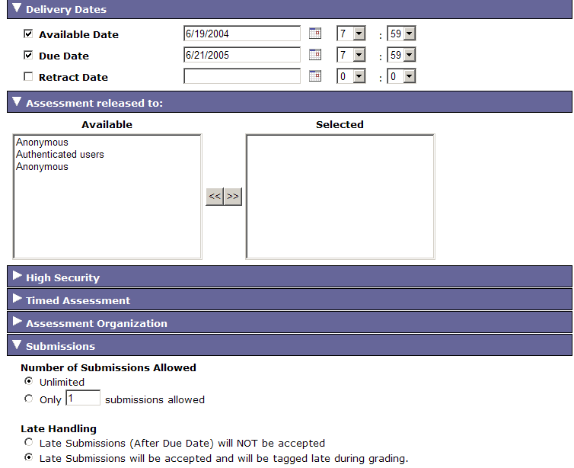

Slide 22
Essay and Project Submission
Use file upload question type for submitting any type of document
Grader can download assignment; upload marked-up file to return to student
Grades are recorded in gradebook

Slide 23
Templates
Create Assessment “Types” for different disciplines, different uses
Select what which choices are available to the instructor.
Hide complexity by making choices for the type (e.g., Self-study always has immediate feedback)
Notes:
<show templates>

Slide 24
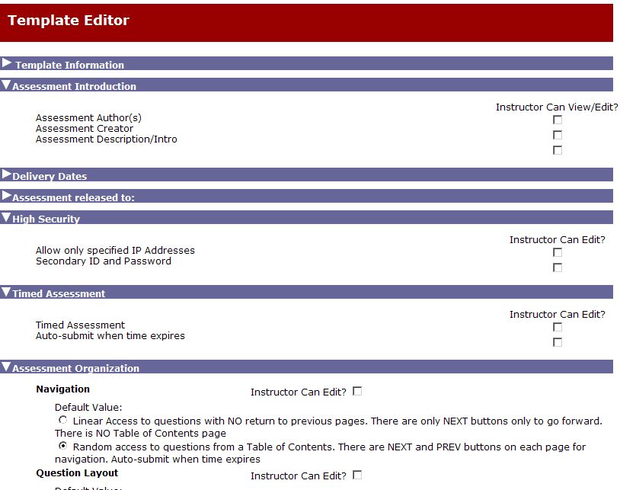

Slide 25
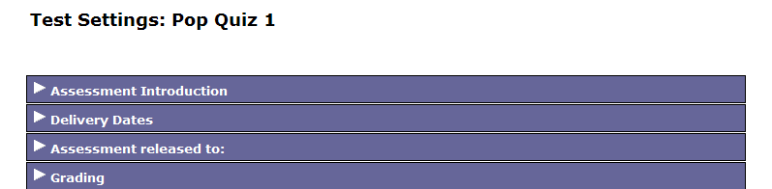

Slide 26
Question Pools
Organize questions into multiple subpools
Export and import questions in IMS QTI format.
Author Questions from within Pool Mgr.
Randomly draw from pools for an assessment
Notes:
<show question pools>

Slide 27
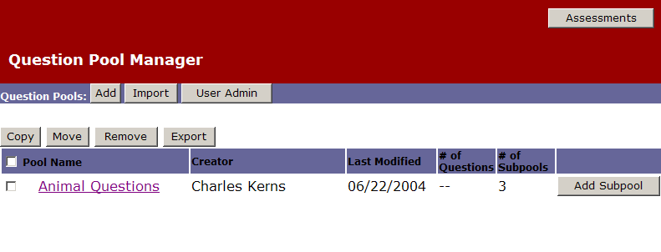

Slide 28
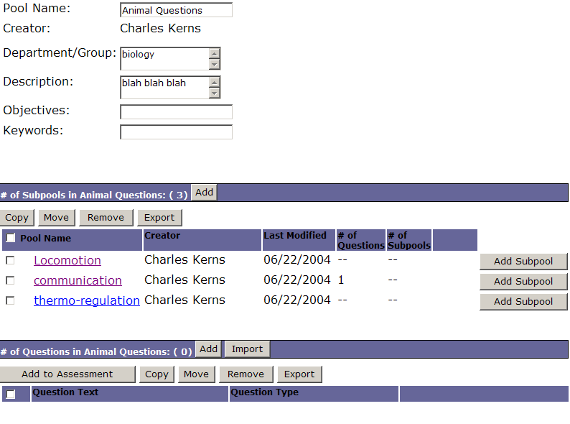

Slide 29
Samigo
Assessment Manager
Lance Speelmon
Indiana University

Slide 30
Agenda
Architecture
Standards
  OKI OSIDS
  IMS QTI
Persistence
  Spring / Hibernate
Sakai TPP Transition

Slide 31
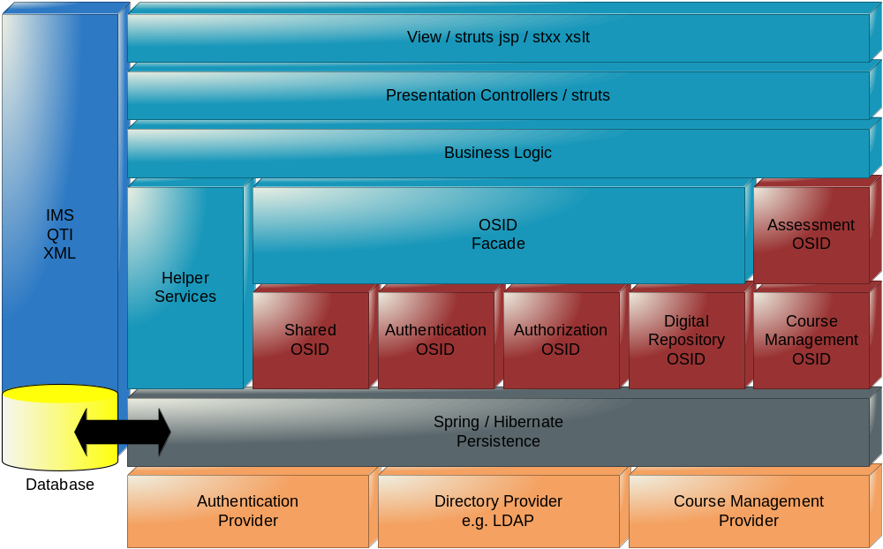
Logical Architecture

Slide 32
OKI OSIDS
Benefits
  Interoperability
  Well defined points of integration
Issues
  Profiling
    Out of Band Agreements
    Expected Behavior

Slide 33
IMS QTI
Benefits
  Interoperability
  Reduced Front-End Modeling
Issues
  Searches / De-normalization
  Branching

Slide 34
Spring / Hibernate
Simplified persistence of objects
Rich mappings
Automated connections
Declarative transactions across service boundaries
Excellent development / deployment cycles

Slide 35
Sakai TPP Transition
Out of Box Experience
Spring / Hibernate completion
Dependency Injection
JSF / Sakai Presentation

Slide 36

SEPP BOFS
Samigo Assessment Manager
  Friday 8:30 – 9:15a: Tabor A Foyer
  Integration / Extension
Spring / Hibernate
  Friday 2:00 – 2:45p: Tabor A Foyer
  CRUD / Transactions
AuthZ
  Friday 2:45 – 3:45p: Tabor A Foyer

Slide 37


Q & A

